Slide 1

TRUCK PLATOONING
MODELLING AND IMPLEMENTATION
Akhilesh Kakkayamkode
Arjun Veeramony
Angel Mary

Slide 2
01
02
03
04
INTRODUCTION
MODELLING
ARCHITECTURE
IMPLEMENTATION

Slide 3
INTRODUCTION
01
Truck Platooning
Signals and Data for Communication
Minimum Distance Calculation

Slide 4
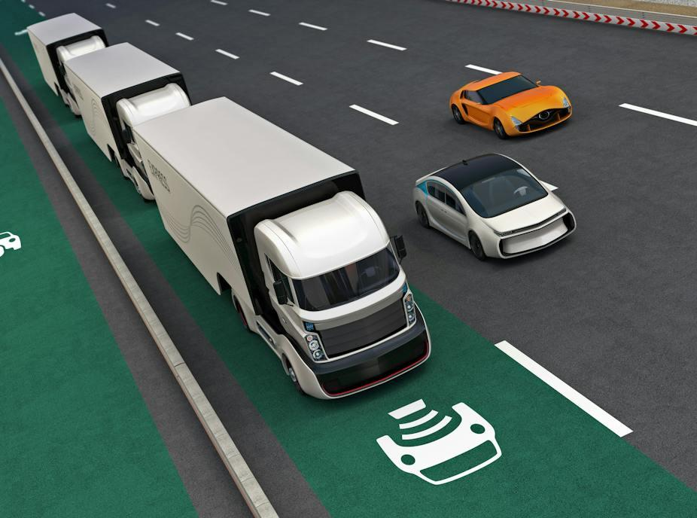
TRUCK PLATOONING
What is Truck Platooning?
Two or more trucks linked to a leading truck.
Benefits of Truck Platooning
Improved Fuel Economy
Reduced Carbon Emissions
Increased Safety
Reduced Traffic Jams
Less Manpower

Slide 5
DATA AND SIGNALS IN COMMUNICATION
PLATOON FORMATION SIGNALS
ACCELERATION/ DECELERATION DATA
CONNECTIVITY CHECK SIGNALS
LANE CHANGE ALERT
OBSTACLE DETECTION ALERT
EMERGENCY ALERT
BRAKING STATUS
TRAFFIC SIGNAL STATUS

Slide 6
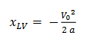
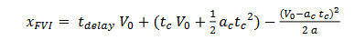
Theoretical Calculation
x_{LV} = Stopping Distance For Leading Vehicle x_{FV1} = Stopping Distance For Following Vehicle 1
V₀ = Velocity at starting of braking ( 25 m/s ) a = Deceleration ( -6 m/s² ) t_{delay} = Communication delay ( 0.1 s )
t_{c}= Comfort brake deceleration period ( 0.5 s)
a_{c}= Comfort brake deceleration ( -3 m/s² )
Minimum distance between Trucks

Slide 7
Theoretical Calculation
x_{LV} = 41.7 m x_{FV1} = 48.6 m Min dist >> x_{FV1} - x_{LV} >> 7.53 m
Considering there can be other external factors, for a safer side we are keeping Minimum distance as 15 m.
Minimum distance between Trucks

Slide 8
MODELLING
02
State Machine Diagrams
Activity Diagram
Sequence Diagram

Slide 9
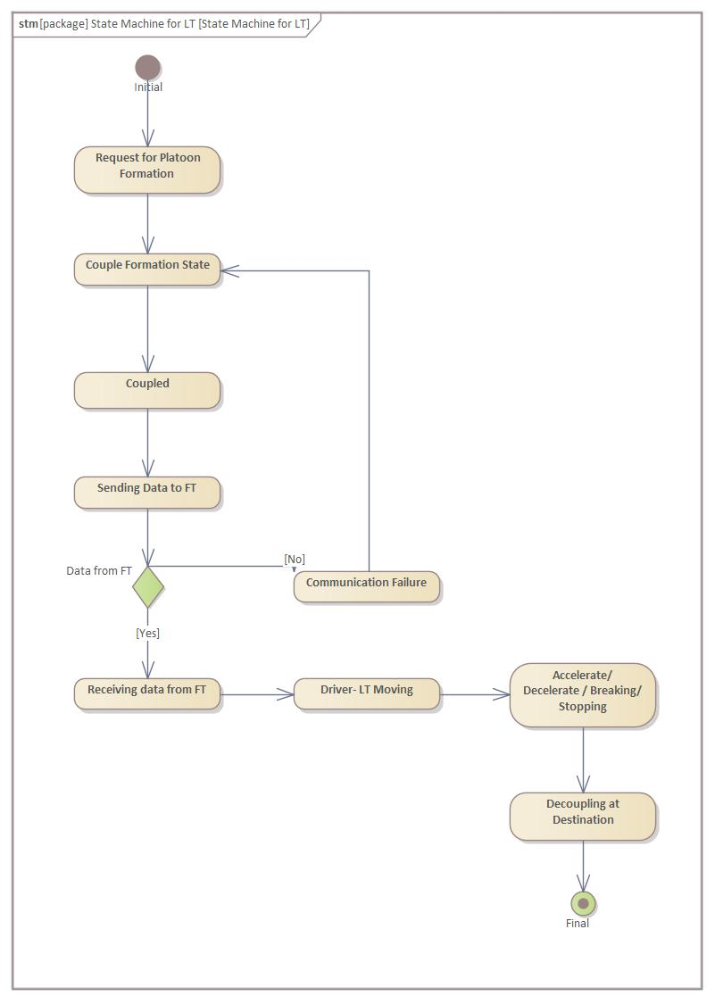
UML MODEL
State Machine Diagram for Leading Truck

Slide 10
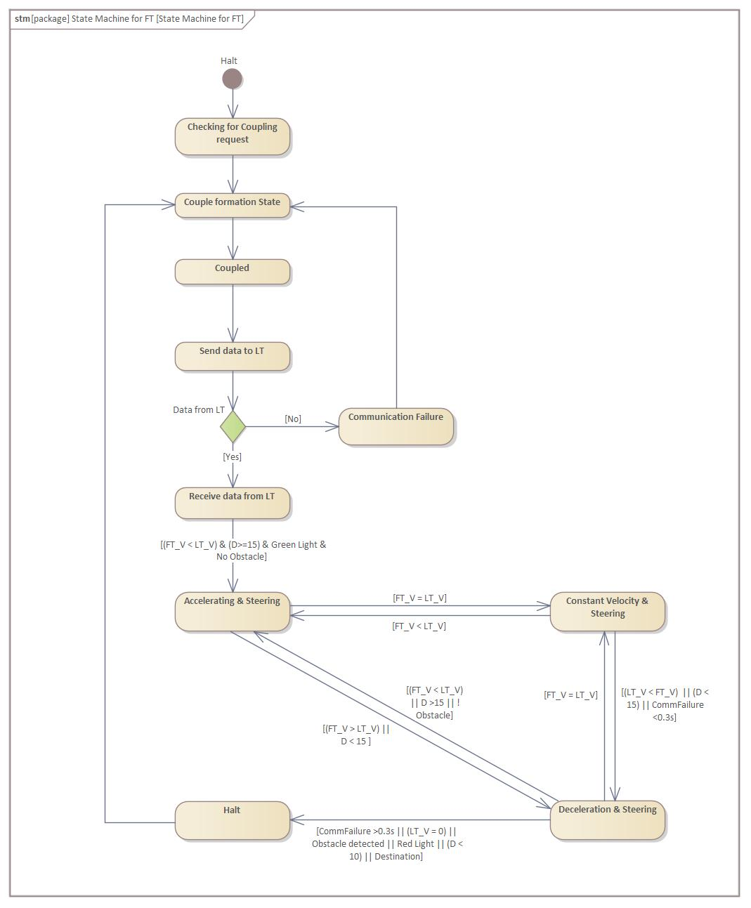
UML MODEL
State Machine Diagram for Following Trucks

Slide 11
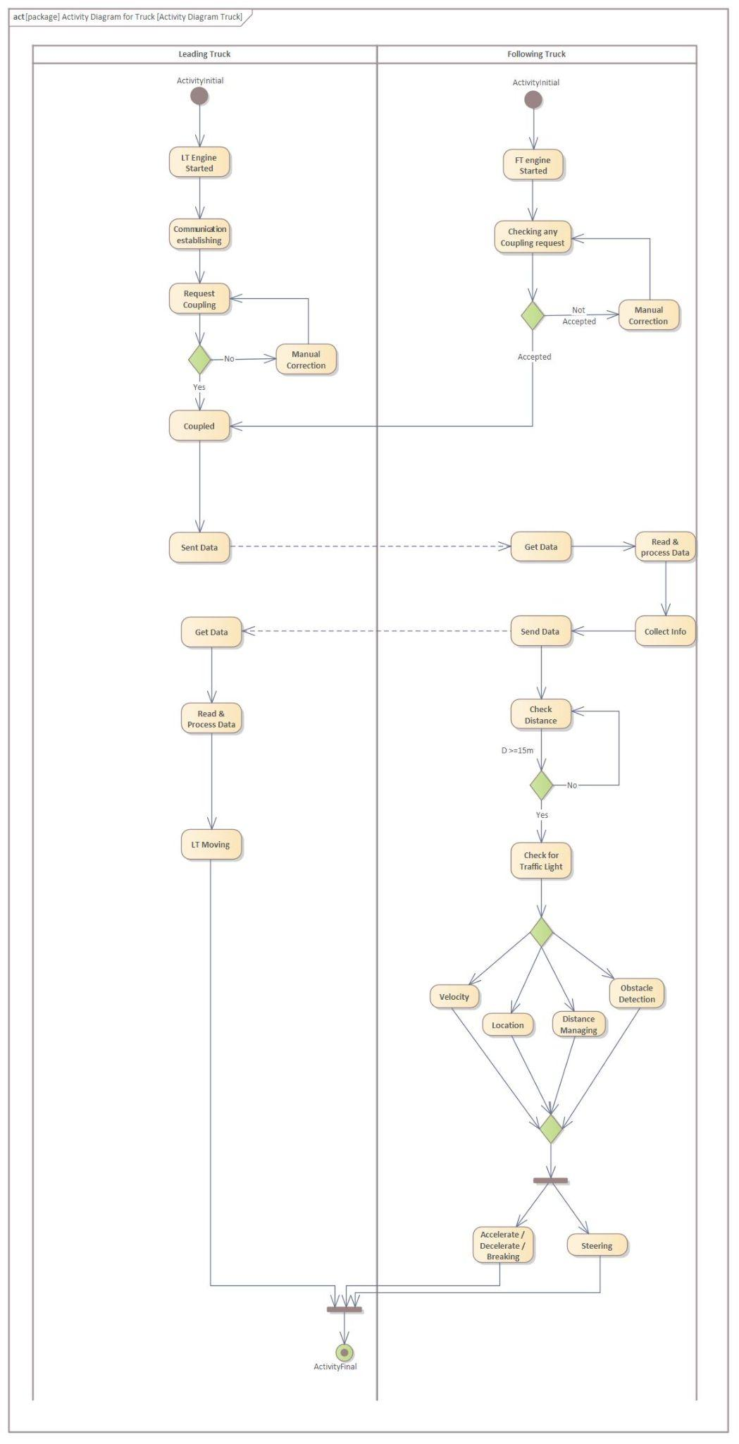
UML MODEL
Activity Diagram

Slide 12
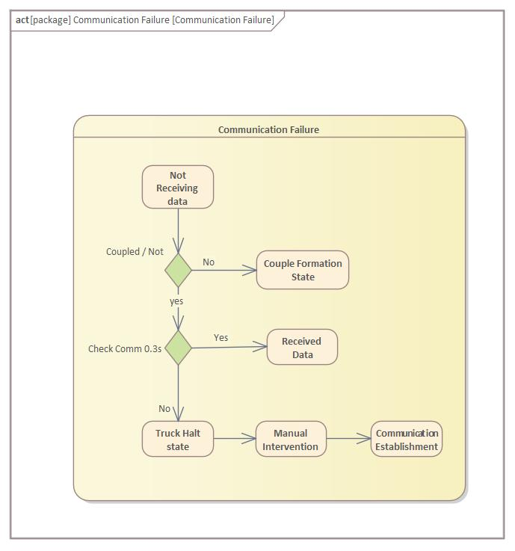
UML MODEL
Communication Failure

Slide 13
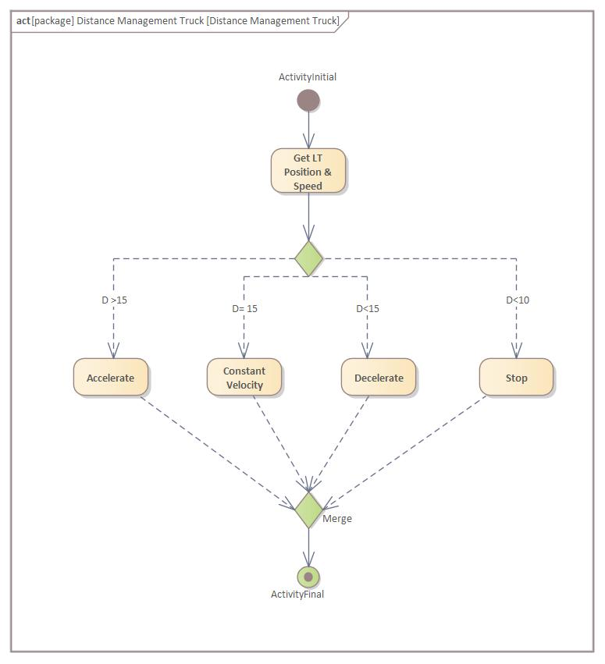
UML MODEL
Distance Management

Slide 14
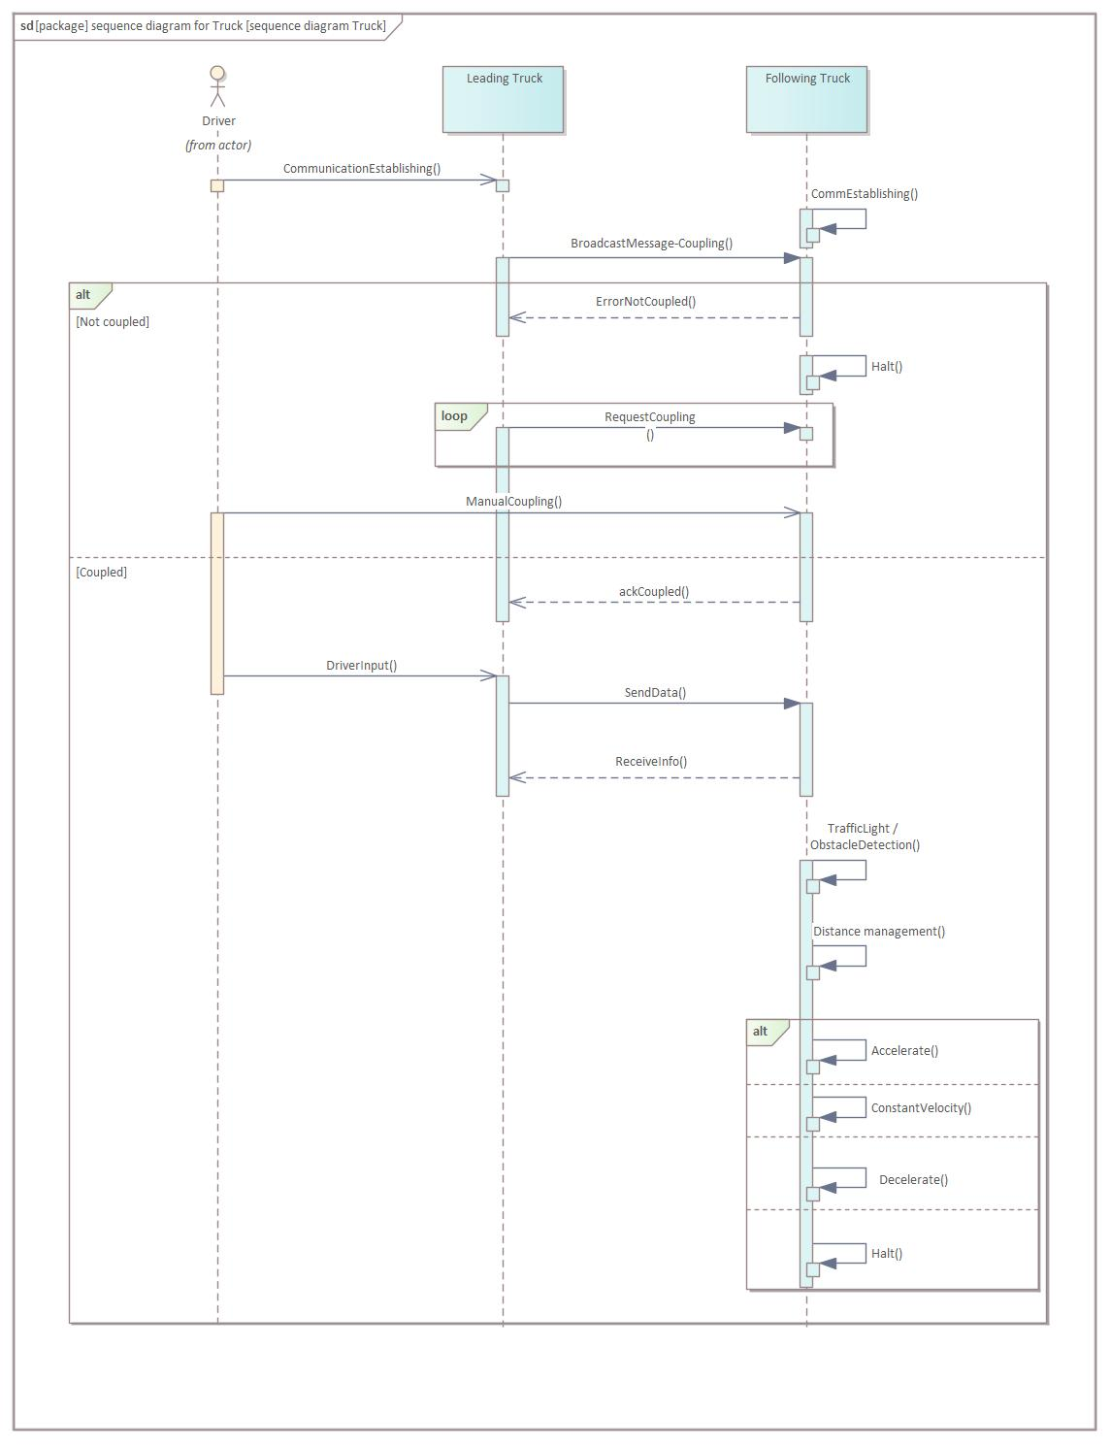
UML MODEL
Sequence Diagram

Slide 15
ARCHITECTURE
03
Parallel Programming Approaches
Comparison
Suggested Approach

Slide 16
PARALLEL PROGRAMMING APPROACHES
ASPECTS | MASTER SLAVE MODEL | NODE ONLY MODEL
CONTROL | Centralized Control with Master Coordinating Tasks | Decentralized Control with each node manages tasks independently
COMMUNICATION | Intensive Communication between Master and Slave | Limited Communication between Nodes
FAULT TOLERANCE | Critical mechanisms needed for Master Slave failures | Distributed Control enhances Fault tolerance
Notes:
These two are the Common Parallel Programming Paradigms.

Slide 17
MASTER SLAVE MODEL
SUGGESTED APPROACH

Slide 18
REASONS
Communication Efficiency:
Adaptability:
Communication between the master and slave vehicles is typically more straightforward in a centralized model.
The master can broadcast commands to all slave vehicles, reducing the complexity of communication protocols.
The master-slave model allows for dynamic adaptation to changing road conditions and traffic scenarios.
The lead vehicle can adjust the platoon's behavior based on real-time data and make decisions that benefit the entire convoy.

Slide 19
IMPLEMENTATION
04
Communication Protocol
Working Approach
GPU Implementation

Slide 20
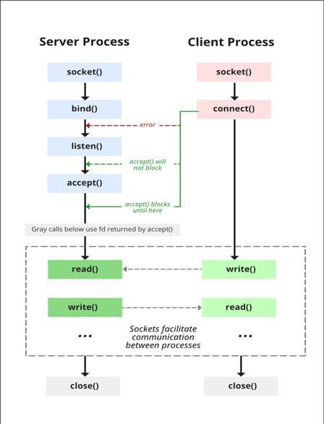
Communication Protocol
TCP/IP SOCKET PROGRAMMING

Slide 21
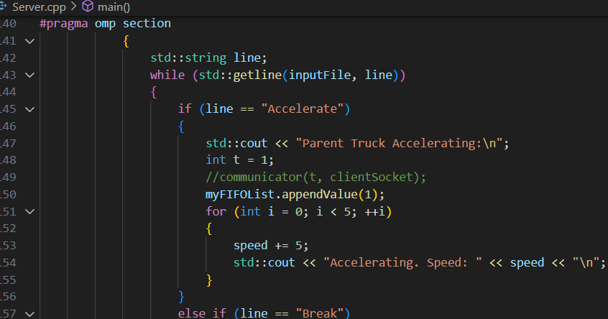
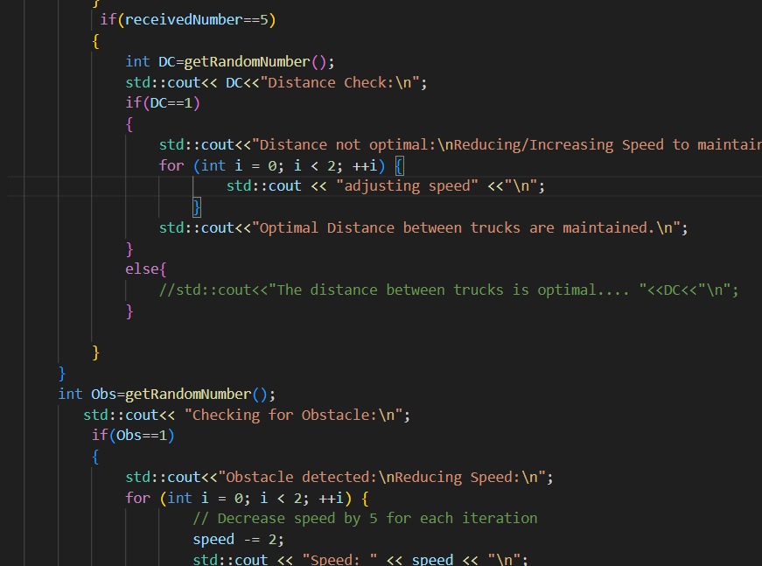
Working Approach

Slide 22
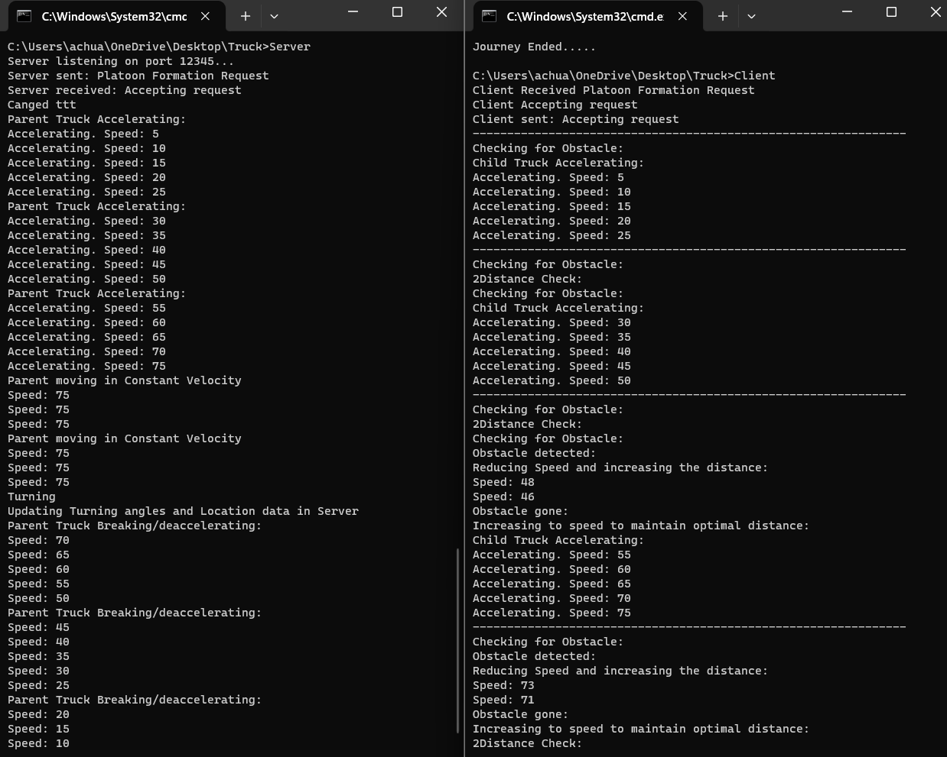
Output

Slide 23


GPU IMPLEMENTATION
GRAPHICS CARD - AMD RADEON 530
OPENCL FRAMEWORK

Slide 24
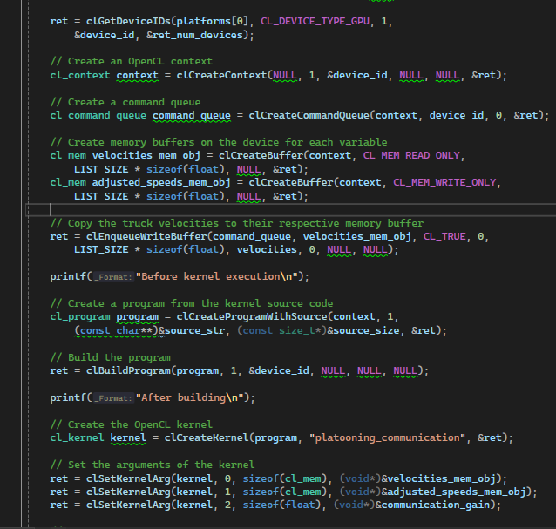
GPU IMPLEMENTATION
HOST CODE

Slide 25
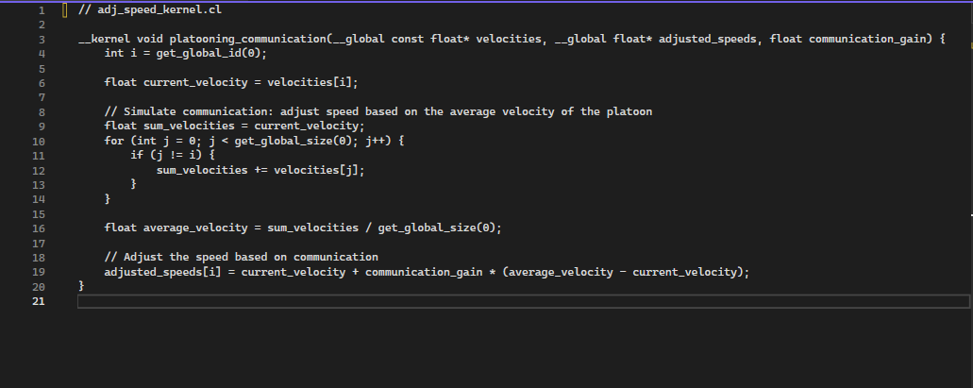
GPU IMPLEMENTATION
KERNEL CODE

Slide 26
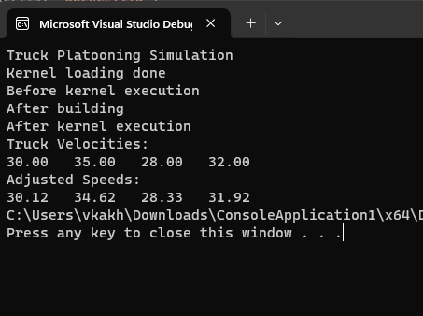
GPU IMPLEMENTATION
OUTPUT

Slide 27
REFERENCE
Truck platooning application - S. Ellwanger, E. Wohlfarth, 2017 IEEE Intelligent Vehicles Symposium (IV)
“An OpenMP Application Programming Interface, Examples”,Version 4.5.0, 11.2016.

Slide 28
THANK YOU!!

